Slide 1
Euglena and Paramecium

Slide 2
Euglena Structure
Euglena are in the domain Eukaryotes
Eukaryotes are cells or organisms with cells that contain a nucleus. The opposite of a eukaryote is a prokaryote. Prokaryotes do not have a nucleus or defined organelles. Eukaryotes include anything under the classification of plants, animals, fungi. Prokaryotes include bacteria, blue-green algae, and mycoplasma.
.

Slide 3
Euglena
Are single-celled organisms with the following structures or organelles: mitochondria, nucleus, vacuole, Golgi apparatus, endoplasmic reticulum, and flagella. Euglena are unique in that the outer layer of the cell includes a flexible membrane called the pellicle. The pellicle supports and contains the plasma membrane, much like a cell wall would in plants. They may also have an eyespot or photoreceptor that functions as a light sensor

Slide 4
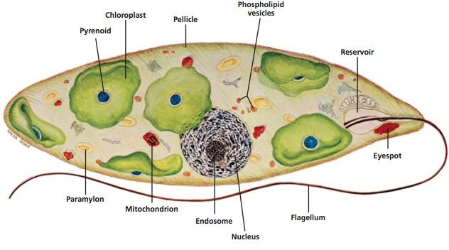
Euglena

Slide 5
Eyespot helps them sense light. Can be autotrophic (produces their own food)
Waste- Contractile Vacuole holds excess water and removes it from the cell.
Movement- Flagella

Slide 6
Paramecium is unicellular and eukaryotic, so they are kept in the kingdom Protista. They are ciliated protozoan and come under phylum Ciliophora.
The cell size varies from 50 µ to 300 µ. The cell is ovoid, slipper or cigar-shaped
The cellular cytoplasm is enclosed in a pellicle. Pellicle consists of an outer plasma membrane.
Cilia protect from the depressions in the pellicle and cover the entire body surface. They are used for locomotion and taking nutrient-rich water inside the oral groove.

Slide 7
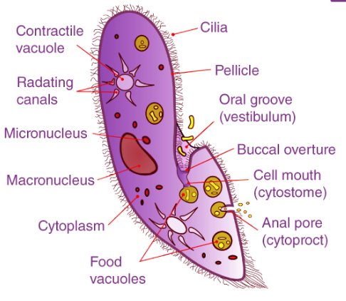
paramecium

Slide 8
Paramecium Reproduction
Asexual Reproduction in paramecium is by binary fission. The mature cell divides into two cells and each grows rapidly and develops into a new organism. Under favorable conditions, Paramecium multiplies rapidly up to three times a day.
Sexual reproduction in Paramecium is by various methods.
In conjugation, two complementary paramecia come together and there is a transfer of genetic material.

Slide 9
Thank you

